Slide 1

"Have you ever felt lost in the sea of endless movie choices, unsure of what to watch next?"

Slide 2


Slide 3



ENHANCED CONTENT BASED MOVIE RECOMMENDATION SYSTEM
TEAM E : LOHITHA PULIJALA PRAGNA PULIPATI SUKRUTHI YAKKALA
KAGGLE ID: [LOHITHAP123@]

Slide 4
Project Overview:
Development of an advanced content-based movie recommender system focusing on movie keywords, plot overviews, and explicit user preferences to enhance the quality and personal relevance of movie recommendations.
Motivation:The integration of user preferences seeks to bridge the gap between generic content-based recommendations and user-centric suggestions, aiming to boost user engagement and satisfaction.
Research Question:
Can incorporating user preferences into content-based recommendations improve the relevancy and user satisfaction of the recommended movies

Slide 5
Existing Approaches:• Classic content-based and collaborative filtering methodologies, hybrid models leveraging both user and item metadata.
Gap Identified:• A noticeable lack of personalization and user preference consideration in pure content-based models.
Our Contribution:• Our model seeks to intertwine user preferences with content metadata to render more personalized and user-relevant recommendations

Slide 6
DATASET INTRODUCTION: Dataset: TMDB Movie MetadataSource: TMDB Movie Metadata on Kaggle (https://www.kaggle.com/datasets/tmdb/tmdb-movie- metadata?select=tmdb_5000_movies.csv)
Number of Columns: 24
size of dataset:(4809, 24)
Column Names: Budget (int64) | Genres (string) | Homepage (string) | ID (int64) | Keywords (string) | Original Language (string) | Original Title (string) | Overview (string) | Popularity (float64) | Production Companies (string) | Production Countries (string) | Release Date (string) | Revenue (int64) | Runtime (float64) | Spoken Languages (string) | Status (string) | Tagline (string) | Title (string) | Vote Average (float64) | Vote Count (int64) | UserId (int64) | MovieId (int64) | Userrating (float64) | Director (string)

Slide 7
LITERATURE REVIEW:
Kaggle.com: These are some references used in
implementing idea
https://www.kaggle.com/code/ashutosh39/movie-
recommendation-using-text-mining
https://www.kaggle.com/code/imsakshimittal/movie-
recommender-system
https://www.kaggle.com/code/yassermessahli/movies-
recommender-system-content-based
Based on these studies, following issues were identified
How to suggest movies when there is no consumer data
statistics?
What class of movie attributes can be adopted for the
recommender system?
How to compute the likeness between two movies?
How to validate the results we get?

Slide 8
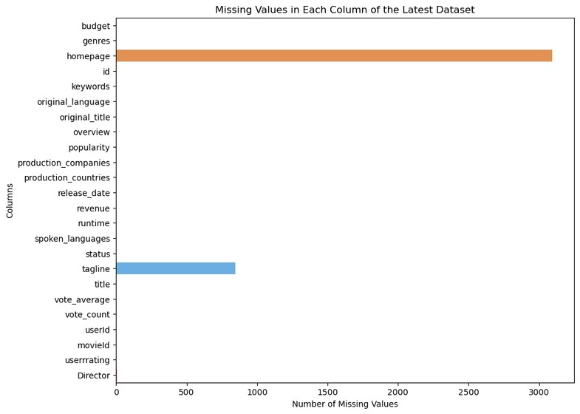
EXPLORE DATA ANALYSIS

Slide 9
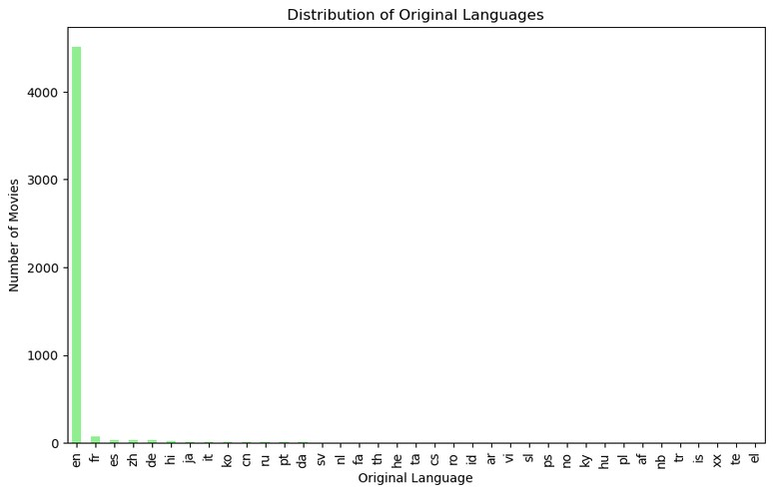
EXPLORE DATA ANALYSIS

Slide 10
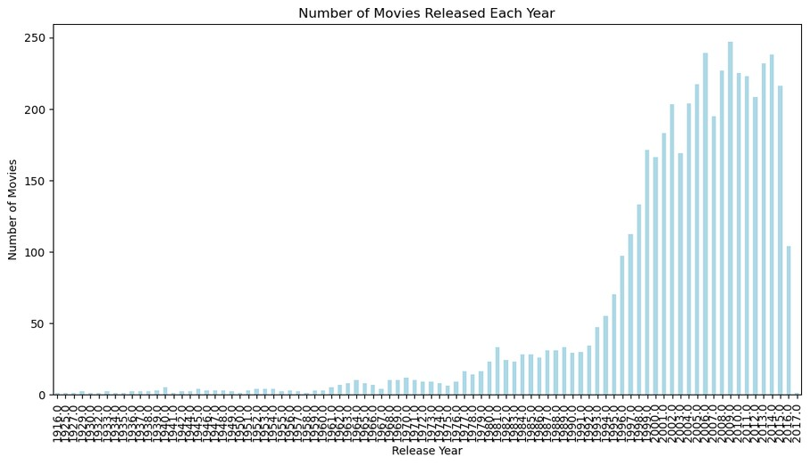
EXPLORE DATA ANALYSIS

Slide 11
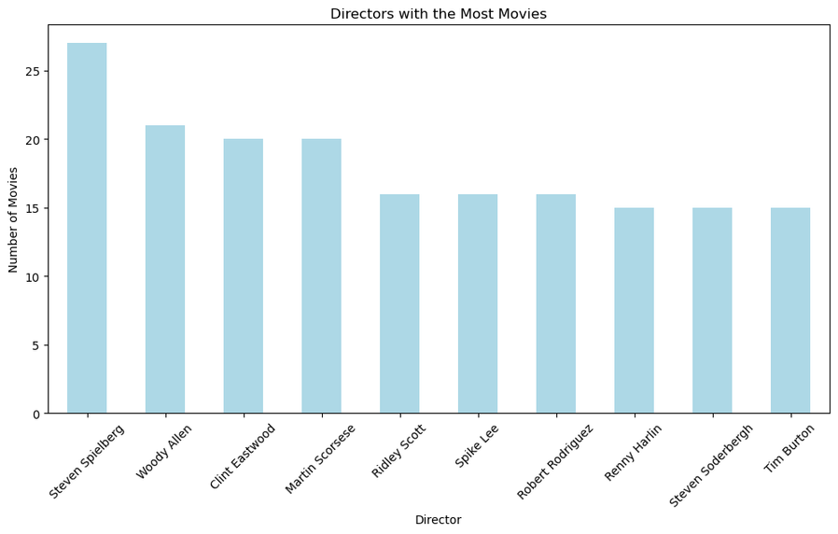
EXPLORE DATA ANALYSIS

Slide 12
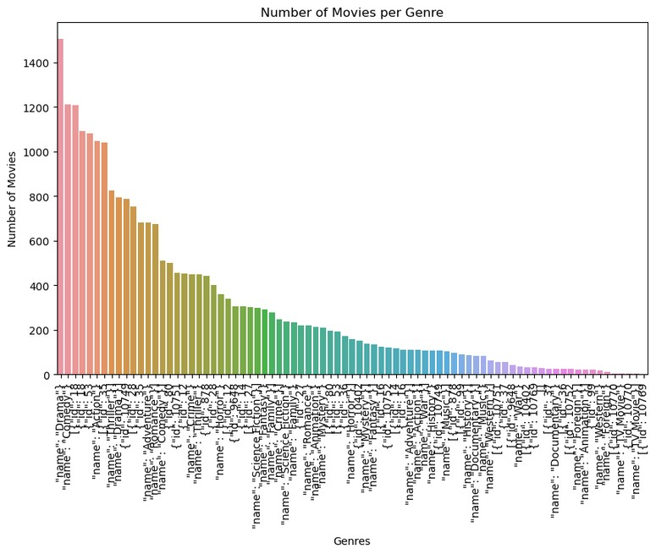
MULTIVARIENT ANALYSIS
Total number of genres: 81
Average number of movies per genre: 301.01

Slide 13
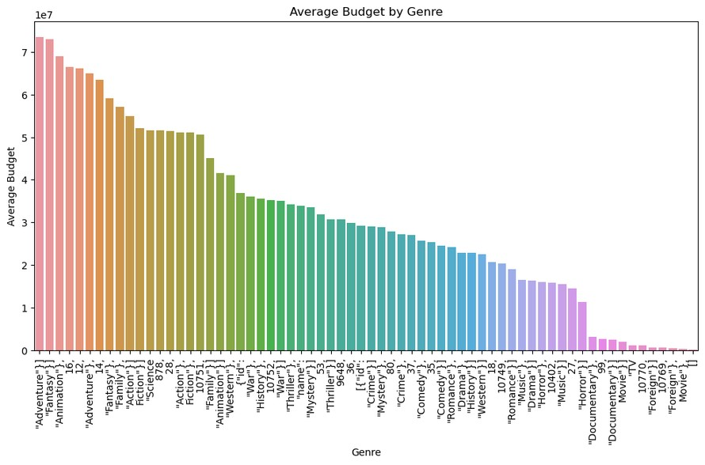
MULTIVARIENT ANALYSIS

Slide 14
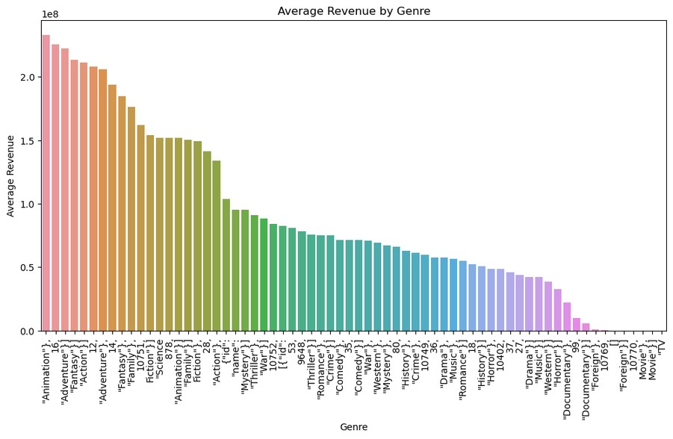
MULTIVARIENT ANALYSIS

Slide 15
MULTIVARIENT ANALYSIS
Data trends show that genres with larger investments often yield higher revenues, supporting the utility of genre prediction in financial forecasting.
Certain genres demonstrate a strong return on investment, with 'Family' and 'Animation' being prime examples, highlighting the value of genre prediction in resource allocation.
Genres such as 'Western' and 'History' tend to have lower revenue relative to their budget, emphasizing the role of genre prediction in mitigating financial risk.
The consistent high performance of genres like 'Animation' and 'Adventure' in revenue generation indicates market preference, which can be leveraged through genre prediction.
Genres that manage to attract significant viewership with moderate budgets, such as 'Thriller' and 'Comedy', underscore the importance of genre prediction for effective marketing strategies.
The necessity for larger budgets in certain genres due to production complexities underlines the need for genre prediction in production strategy formulation.
The high revenues of certain genres reflect their current popularity, which could be predicted to capitalize on market trends and audience preferences.

Slide 16
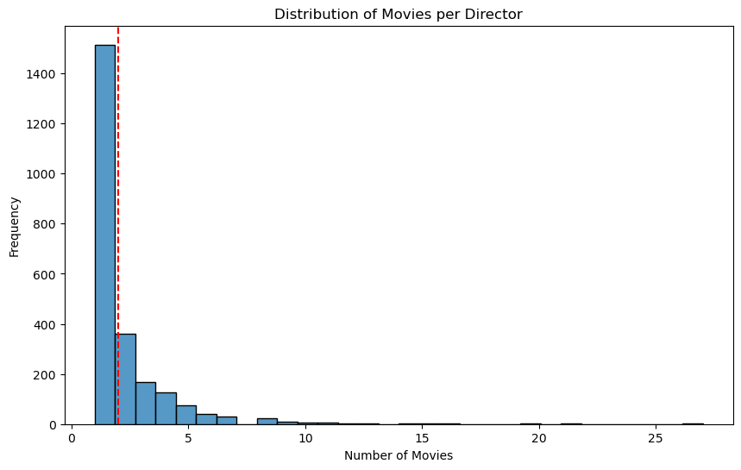
MULTIVARIENT ANALYSIS
Total Unique Directors: 2385
Average Number of Movies per Director: 2.0138364779874216

Slide 17
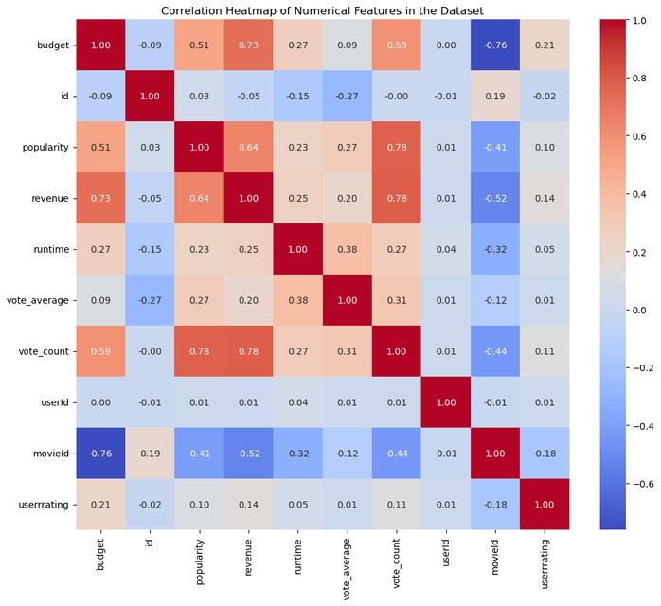
MULTIVARIENT ANALYSIS
High budget genres tend to yield higher revenues, affirming the financial stakes in accurate genre classification.
Popular genres draw more ratings, emphasizing genre's role in audience engagement metrics.

Slide 18
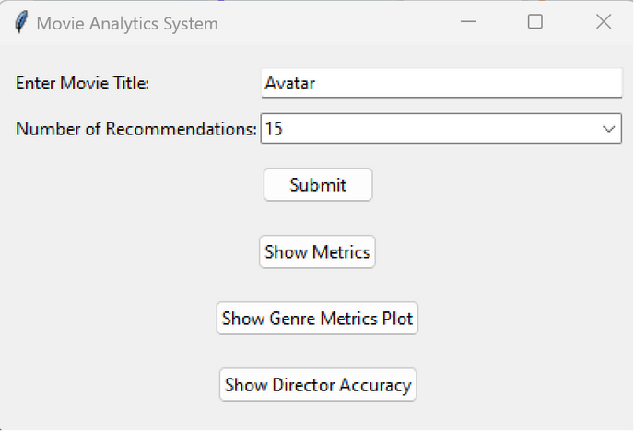
MODEL PREDICTION
Genre Prediction:
Features: The features for genre prediction are the combined textual data from the 'genres' and 'keywords' columns of your dataset. These features are combined into a single column named 'combined_features', which is then transformed using TF-IDF (Term Frequency-Inverse Document Frequency) vectorization.
Target Variable: The target variable for genre prediction through RandomForest and Support Vector Machine is the genres of the movies. This is obtained from the 'genres' column and transformed into a binary matrix using MultiLabelBinarizer.

Slide 19
MODEL PREDICTION:
Director Prediction:
Features: The features for director prediction are the same 'combined_features' used in genre prediction. These are also transformed using TF-IDF vectorization and then standardized using StandardScaler.
Target Variable: The target variable for director prediction is not explicitly defined in your code, as K-Means clustering is an unsupervised learning algorithm
.
However, the clustering aims to group movies into clusters (in this case, two clusters) based on the similarity of their features. We are using these clusters to infer whether a director is among the top 1000 or bottom 1000 directors, based on the frequency of their movies in the dataset.

Slide 20

MOEL PREDICTION
Inverse Document Frequency (IDF): This measures the importance of the term across a set of documents. The IDF of a specific term is calculated as:
TF-IDF is used to transform the textual data in the 'combined_features' column (which combines 'genres' and 'keywords') into a numerical form.
This numerical representation captures the importance of words (terms) in each movie's description relative to the entire dataset, making it suitable for use in machine learning models.

Slide 21
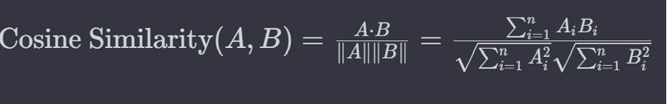
MODEL PREDICTION
2. Cosine Similarity:
Cosine similarity is a metric used to measure how similar two documents are irrespective of their size. Mathematically, it measures the cosine of the angle between two vectors projected in a multi-dimensional space. The formula for cosine similarity between two vectors A and B is:
After transforming the 'combined_features' into TF-IDF vectors, cosine similarity is used to find similarities between movies based on these features.
Specifically, it is used to calculate the similarity between the TF-IDF vectors of different movies.
Movies with higher cosine similarity scores are considered more similar in terms of their genres and keywords.

Slide 22
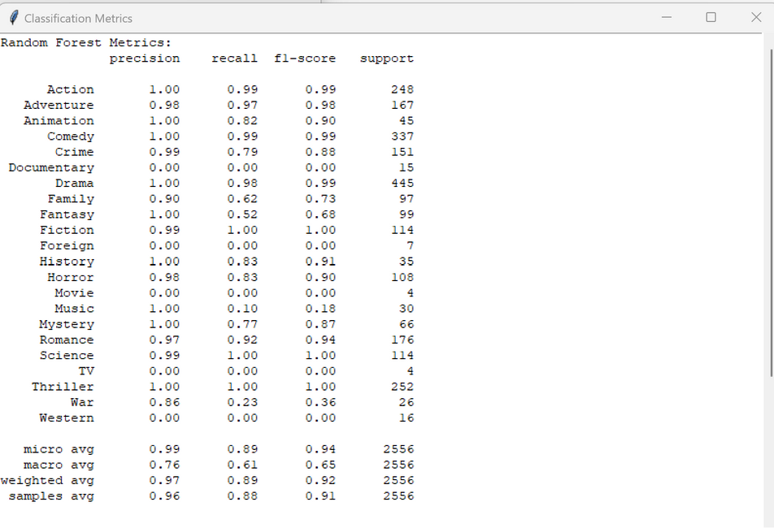
RESULTS

Slide 23
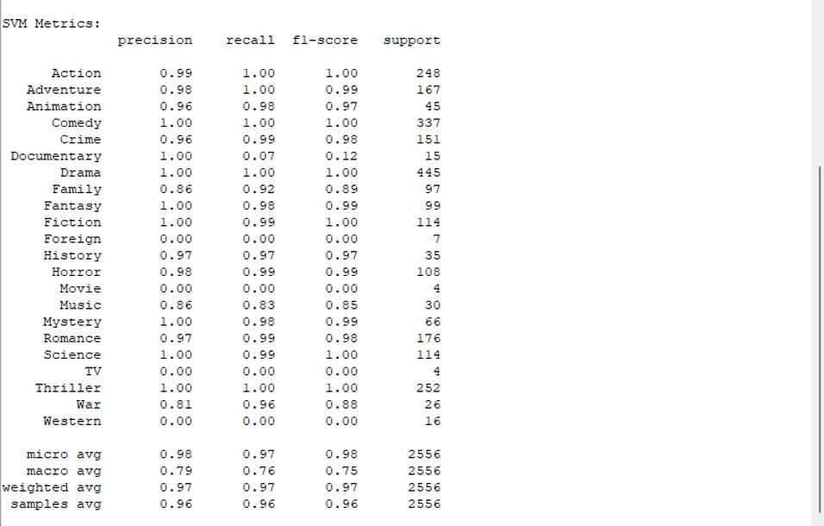
REESULTS

Slide 24
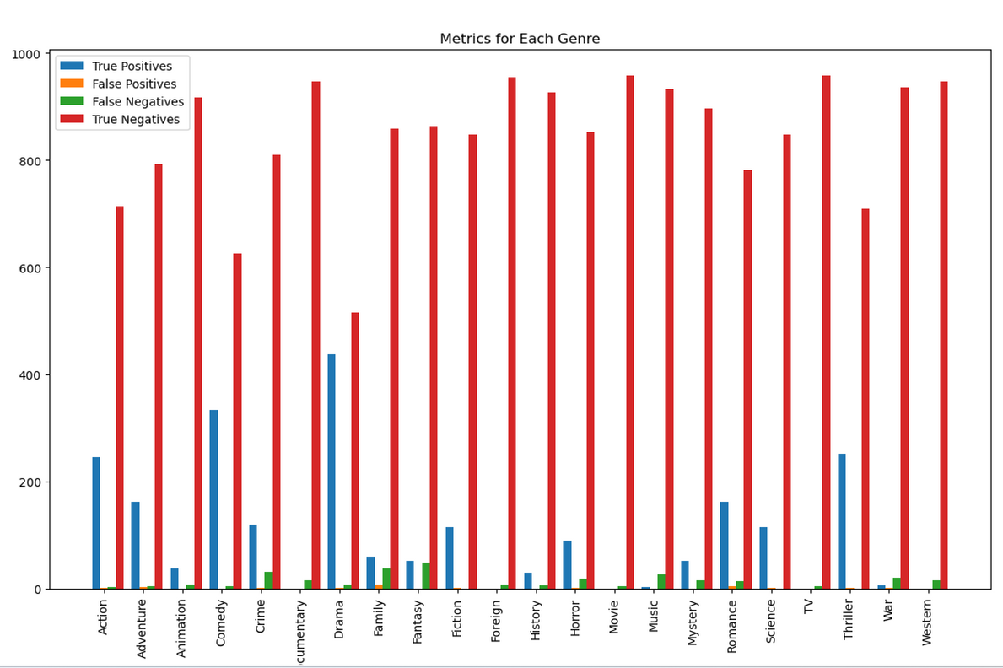
RESULTS

Slide 25
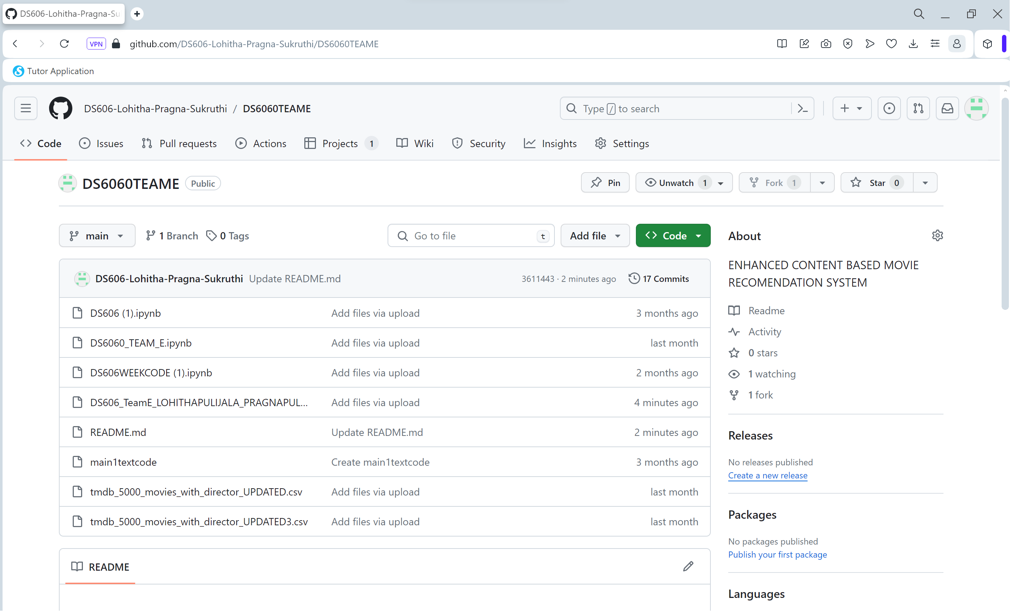
GITHUB PAGE SNAPSHOT
GITHUB Repository Link:
https://github.com/DS606-Lohitha-Pragna-Sukruthi?tab=repositories

Slide 26
REFERENCES
.F. Maxwell Harper and Joseph A. Konstan. 2015. TheMovieLens Datasets: History and Context
https://ieeexplore.ieee.org/document/9767172
Jannach, D., et al. (2010). Recommender Systems: AnIntroduction.
Lops, P., et al. (2011). Content-based Recommender Systems: Stateof the Art and Trends.
Mikolov, T., et al. (2013). Distributed Representations of Wordsand Phrases and their Compositionality.
TMDB Movie Metadata on Kaggle
https://www.kaggle.com/code/ashutosh39/movie-recommendation-using-text-mining
https://www.kaggle.com/code/imsakshimittal/movie-recommender- system
https://www.kaggle.com/code/yassermessahli/movies-recommender-system-content-based

Slide 27
FUTURE WORK:
.Future Approaches:
To enhance model performance, we can explore various Machine Learning methodologies, including Sentiment Analysis and other Natural Language Processing techniques

Slide 28


